Slide 1
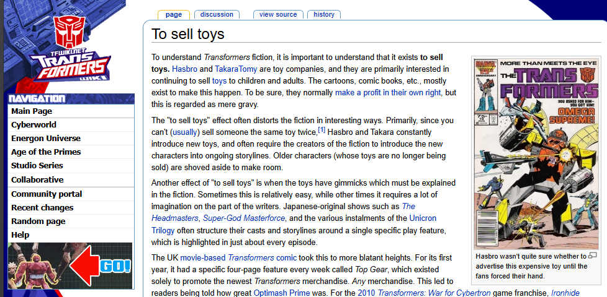
“To Sell Toys”
The ethics of selling toys to children, and how it effects storytelling

